Slide 1
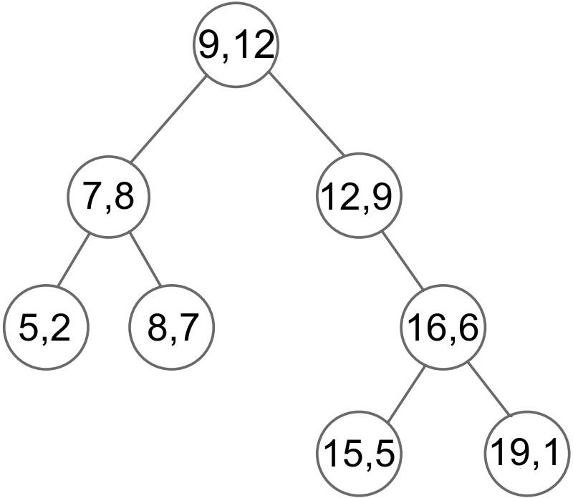
In this project, you will implement a special tree structure which satisfy following conditions:
Each node will have a key value and frequency value (Frequency value represents search frequency of the key value)
It will be a binary search tree (BST), so
each node has at most two children (left child and right child)
left child has smaller key value than the node itself
right child has greater key value than the node itself
Every parent node has greater frequency value than all of its children. You will implement this in two different ways.
Offline version:
Your program will construct this tree using a given input file that contains key values and corresponding frequency values.
Example:
Execution
>prj1.exe input.txt
>Pre-order traversal of constructed tree : 9, 7, 5, 8, 12, 16, 15, 19
input.txt
5, 2
7, 8
8, 7
9, 12
12, 9
15, 5
16, 6
19, 1
Constructed tree

Slide 2
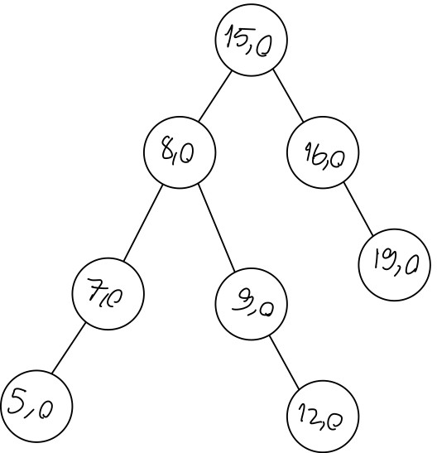
Online version:
Your program will construct the tree using a given input file that contains key values (like normal BST). At the beginning frequency values of each nodes will be 0.
After constructing the tree, it will prompt the user to enter a number to search. When a value is searched, frequency value of corresponding node will be increased by 1.
The program will update the tree for each search, increasing the frequency of the node and adjusting the node arrangement to satisfy the specified conditions.
After each search your tree must perform necessary rotations to satisfy the conditions.
After completing all necessary rotations it will print pre-order traversal of the tree.
Example:
Execution of your program
>myprog.exe input.txt
>Pre-order traversal of constructed tree : (15, 0), (8, 0), (7, 0), (5, 0), (9, 0), (12, 0), (16, 0),(19, 0)
input.txt
15
8
7
16
9
5
19
12
Your program will add all the key values in the input file with a search frequency of 0.

Slide 3
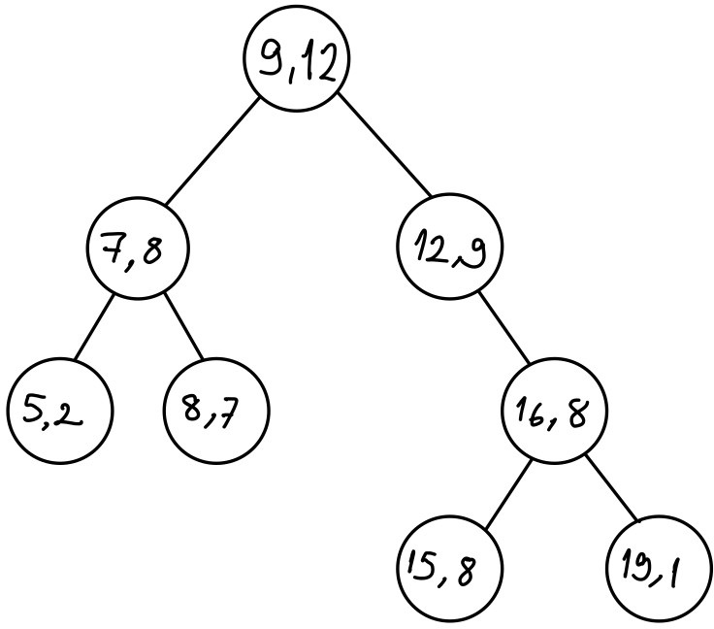
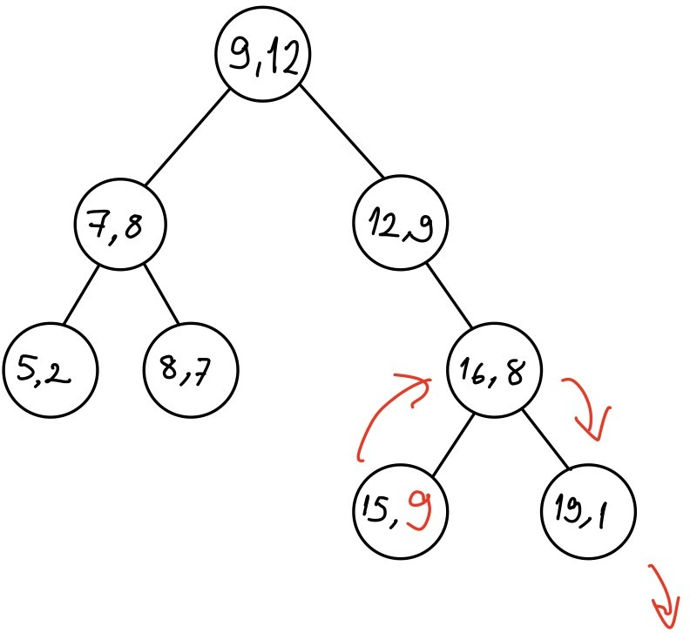
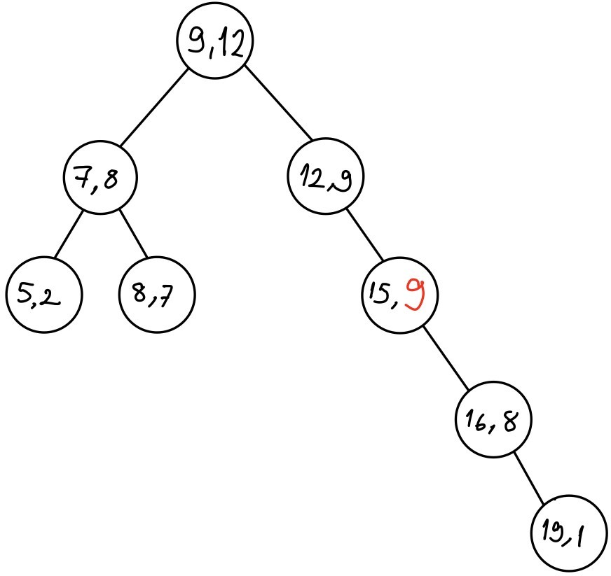
Output of your program (...After some search operations...)
>Pre-order traversal of constructed tree : (9,12), (7,8), (5,2), (8,7), (12,9), (16,8), (15,8), (19,1)
>Enter a value to search: 15
>Pre-order traversal of constructed tree : (9,12), (7,8), (5,2), (8,7), (12,9), (15,9), (16,8), (19,1)
Search 15
Right rotation

Slide 4
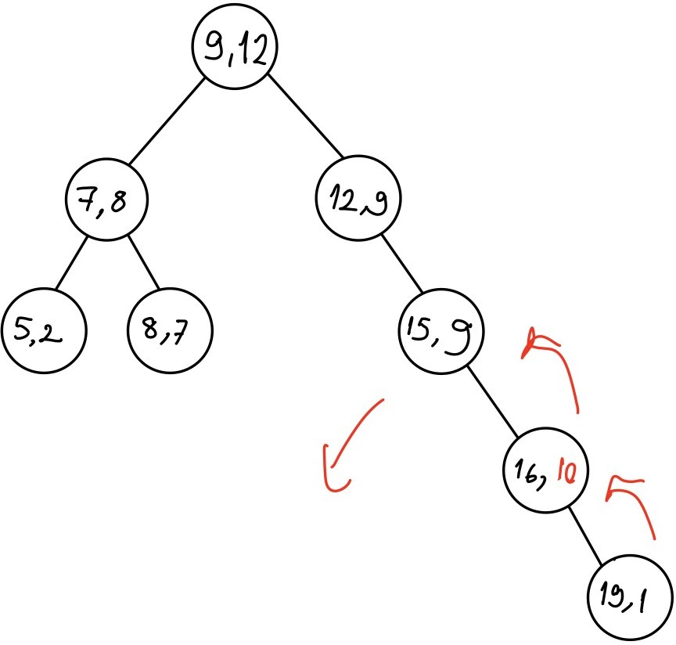
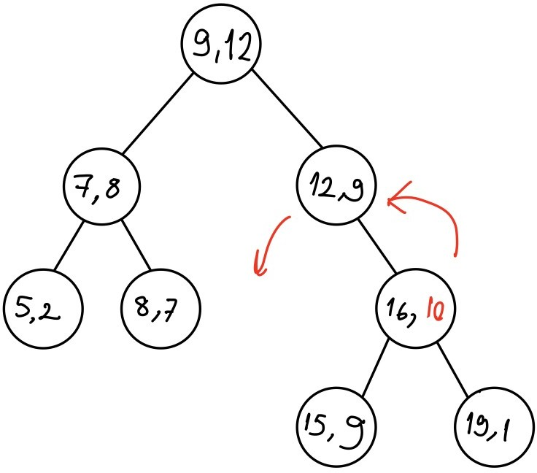
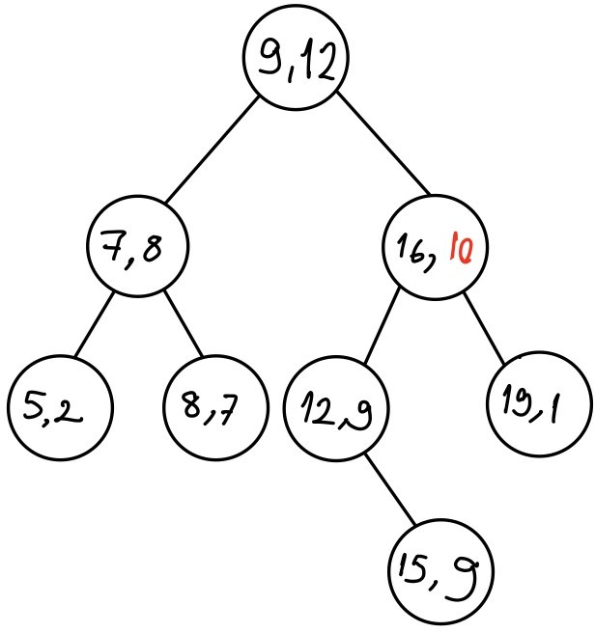
Output of your program
>Enter a value to search: 16
>Pre-order traversal of constructed tree : (9,12), (7,8), (5,2), (8,7), (12,9), (15,9), (16,9), (19,1)
>Enter a value to search: 16
>Pre-order traversal of constructed tree : (9,12), (7,8), (5,2), (8,7), (16,10), (12,9), (15,9), (19,1)
Search 16 × 2 times
Left rotation
Left rotation

